Slide 1
Stored Procedure Parameters and Results Ordering
CMPE 2400
Databases

Slide 2
Results Ordering
Often, the number of results returned by a query will be plentiful.
  Unfortunately, these plentiful results will, more often than not, be returned to you in an order that is not very useful.
  Using the order by clause, you may specify how you want your result set to appear.

Slide 3
Sorting with order by
You may specify the sort order, or group of orders, for the result set returned by a select statement.
select field1, field2, … , fieldN
from table
where condition
order by field1 [asc/desc], field2 [asc/desc], …
  where: asc sort ascending (default)
desc sort descending

Slide 4
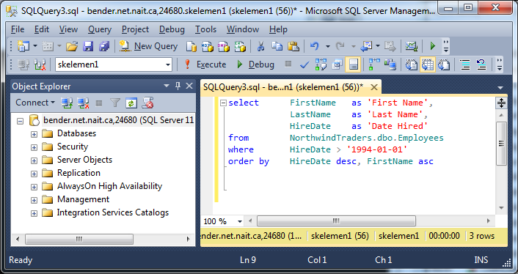
Sorting with order by
Display an employee list of employees hired after January 1, 1994, sorted in descending order by Hire Date and then ascending order by first name.

Slide 5
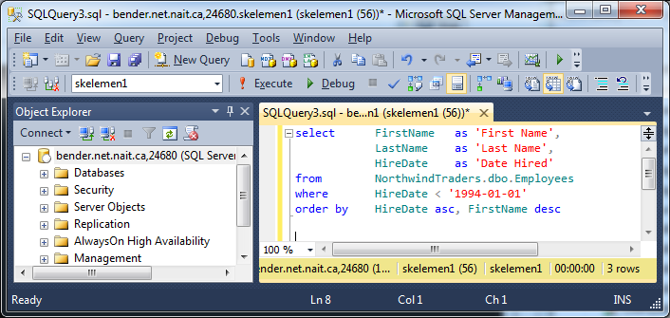
Sorting with order by
Display an employee list of employees hired on or before January 1, 1994, sorted in ascending order by Hire Date and then descending order by first name
  Another way to say this would be to sort by FirstName in descending order within HireDate in ascending order

Slide 6
Stored Procedure Parameters
As with functions, SQL stored procedures start to show their true power with the addition of parameters
Remember that in SQL Server, but not necessarily other DBMSs, it is mandatory to preface all parameter names with the @ symbol

Slide 7
Parameters
Logically, when we declare a parameter, we must also provide a data type for the parameter.
  This type may be any type found in the section covered earlier regarding variable types.
A default value may also be assigned to a parameter if no value is supplied.
By default, parameters are input only, but we may apply the output modifier to allow the parameter value to be used for output as well
  Consider this to be like a reference variable in C#

Slide 8
Extending the Syntax
The only part of the creation syntax which must be added to is the parameter specification.
create proc[edure] SP_ProcedureName
[@Parameter1Name data type] [= DefaultValue] [output],
[@Parameter2Name data type] [= DefaultValue] [output]
as
SQL statement
go

Slide 9
Parameter Example
A simple use of a parameter would be having an adjustable value in our where clause.
  Let us adjust the procedure from the previous example to only retrieve author’s names where the first name begins with a particular letter.
  We will set a default value of ‘M’
  Note that because the procedure has already been created, you may either drop the procedure and recreate it, or change your create keyword to alter, as has been done on the following slide.

Slide 10
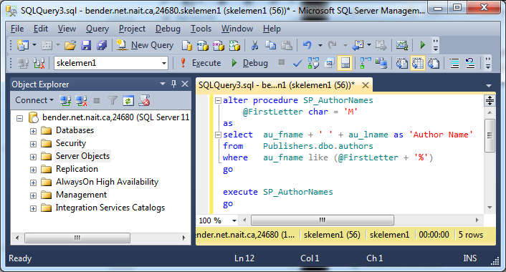
Parameter Example

Slide 11
Default Parameter Results
Author Name
-------------------------------------------------------------
Michel DeFrance
Marjorie Green
Morningstar Greene
Michael O'Leary
Meander Smith
(5 row(s) affected)

Slide 12
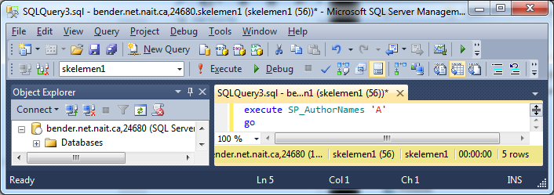
Supplying a Parameter
Now we try supplying the letter ‘A’
  This is done by supplying the value(s) immediately following the execute call to the stored procedure
    Note that there are no brackets surrounding the parameter list
    If more than one parameter is to be supplied, they must be separated by commas.

Slide 13
New Results
Author Name
-------------------------------------------------------------
Abraham Bennet
Ann Dull
Albert Ringer
Anne Ringer
Akiko Yokomoto
(5 row(s) affected)

Slide 14
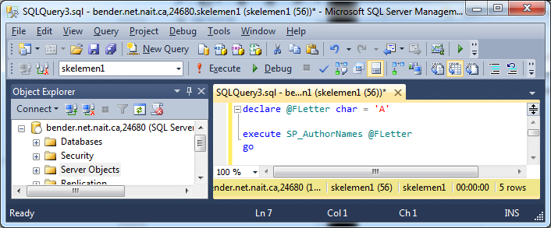
Supplying a Parameter
The value(s) supplied may also be variables.
  The variable(s) in question must first be declared before the stored procedure call.
    Quite logically, the data types of the variables which are supplied to a procedure must match the data types of the parameters required by the procedure being executed.

Slide 15
Error checking
A stored procedure may also return a value
  This is generally used for returning error codes.
  The built in system variable @@error may be used for this task.
    If an error is encountered in the execution of the procedure, this value will be non-zero
  As with other languages, the return value must be stored to be useful, otherwise it is lost to limbo.

Slide 16
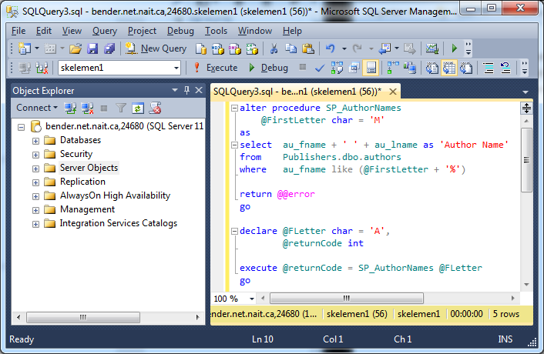
Error Checking Example
Modify your stored procedure to return the error code, call it, and store the returned value.

Slide 17
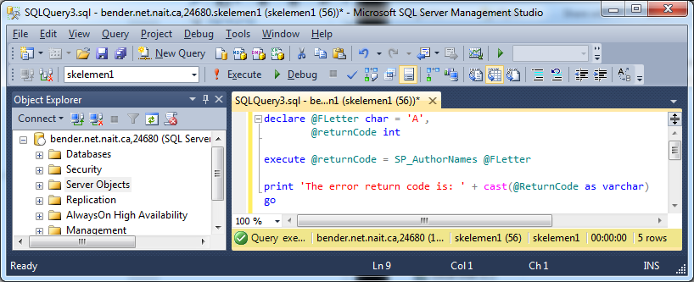
Checking the code
To see the return value of the execution along with the result set, use the following immediately after the execute statement, but before a go.

Slide 18
Error Code Results
Using text mode for your results will yield the following:
  Author Name
  -------------------------------------------------------------
  Abraham Bennet
  Ann Dull
  Albert Ringer
  Anne Ringer
  Akiko Yokomoto
  (5 row(s) affected)
  The error return code is: 0

